Slide 1
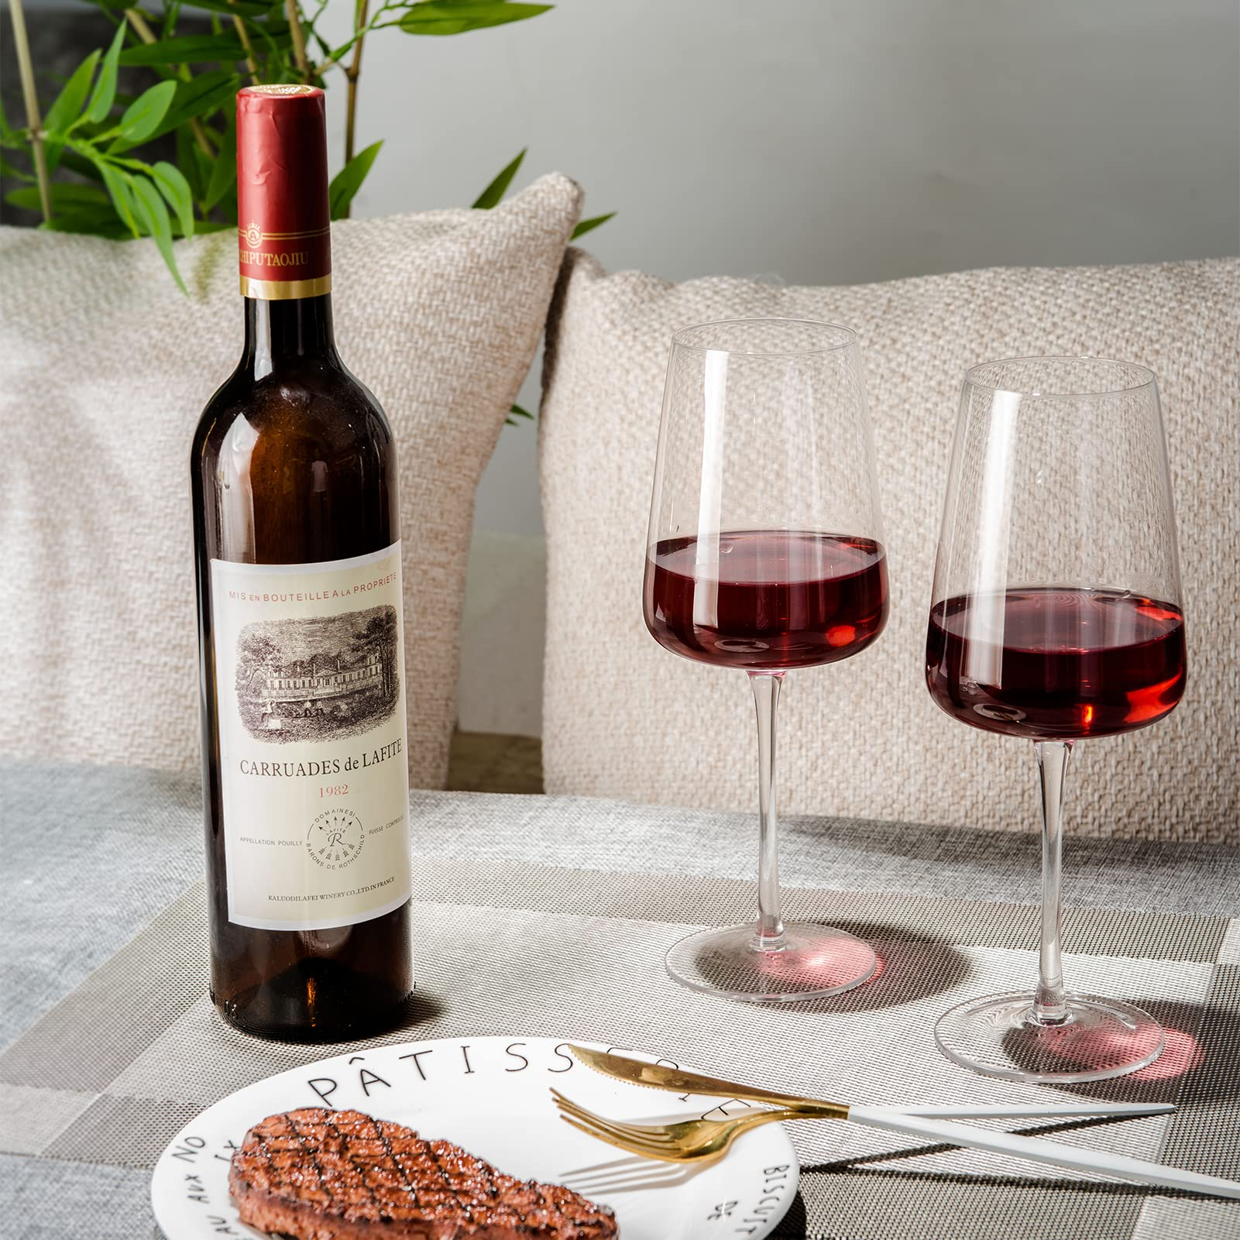
Data Science Project
-Red Wine
ENGR 241
Nicholas Katzenberger, Adam Fiorito, Laszlo Feledy

Slide 2

Introduction to the Data
Data sheet from University of Minho, Portugal
Produced by Professor Paulo Cortez
Has 12 columns of chemical and observational data about the wine
Describes Portuguese "Vinho Verde" wine
Paulo Cortez,
Source: https://pcortez.dsi.uminho.pt/

Slide 3
Why We Chose This Dataset
Straightforward to view correlations between certain variables in the dataset
Wanted to figure out what determined quality
Wanted to see what differs in Portuguese wine compared to American brands

Slide 4
Important Terms
Mean: Average of all values in a population
Standard Deviation: Determines how far away
population numbers are from the mean
Linear Regression: linear relationship to describe the correlation between an independent variable(s) and a dependent variable… y = mx + b
ANOVA table: breaks down components of variation in a regression relationship.

Slide 5
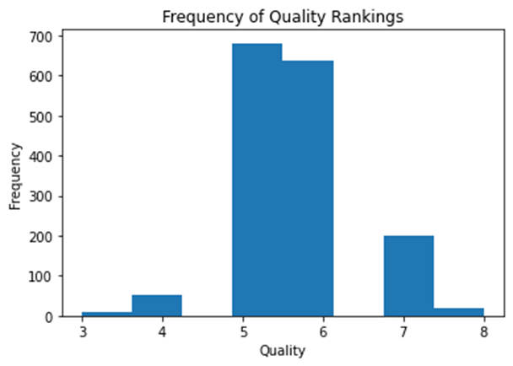
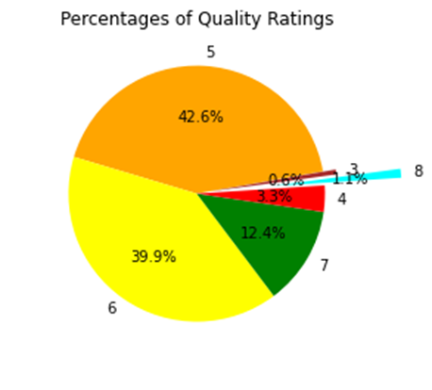
Data Analysis
Histogram of Quality ratings:
Pie chart of same data
Average (Mean) quality: 5.636 Standard deviation: 0.808
Minimum: 3, Maximum: 8

Slide 6
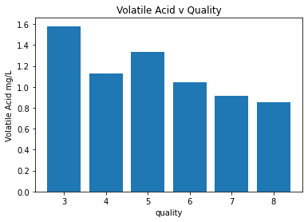
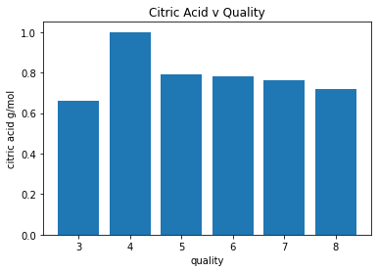
Data Analysis
Quality improved as Volatile Acid decreased …..But this was not as consistent with Citric Acid

Slide 7
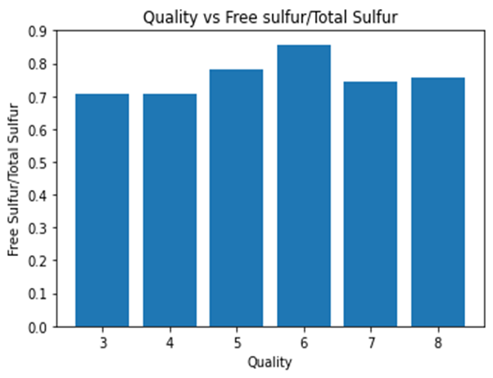
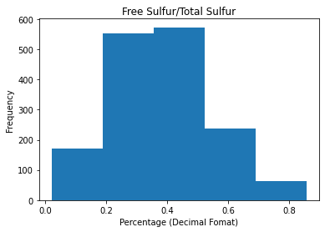
Data Analysis
0.4 to 0.5 most common ratio between Free and Total Sulfur, but the mean was 0.38
Ratio of Free Sulfur to Total Sulfur had little to no relation on Quality rating. Most qualities had close to a 0.7 ratio

Slide 8
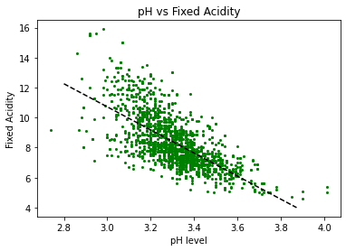
Simple Linear Regression
ANOVA Table
Source of Variation | Deg. of Freedom | Sum of Squares | Mean Sum of Squares | F
pH | 1 | 2259.62 | 2259.62 | 1396.21
Residual | 1597 | 2584.58 | 1.618397
Total | 1598 | 4,844.20
Line equation: y = -7.7023x + 33.8228
R-squared: 0.466 α = 0.05
tcrit = t0.025,∞ = 1.96 tcalc = 37.366: Model is signficant
| t_{calc}| > | t_{crit}|

Slide 9
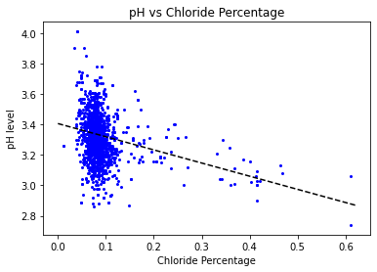
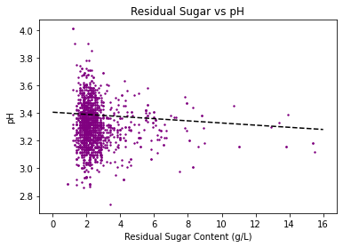
Multi Linear Regression
Y = -0.8564x + 3.4058 (chlorides graph)
Y = -0.0078x +3.4058 (sugar graph)

Slide 10
Multi- Linear Regression: Anova Table and Statistics
Source of Variation | Deg. of Freedom | Sum of Squares | Mean Sum of Squares | F
Chlorides | 1 | 2.675 | 2.867 | 129.934
Residual Sugar | 1 | 0.192 | 0.192136
Residual | 1596 | 35.221 | 0.022
Total | 1598 | 38.088
R² = 0.074 α = 0.05
tcrit = t0.025,∞ = 1.96
Tcalc (chlorides) = -10.84
Tcalc (sugar) = -2.6
| t_{calc}| > | t_{crit}| (For both values)
Model is Significant
Y = -0.8564x₁ -0.0078x₂ + 3.4058 (multi-linear model)

Slide 11
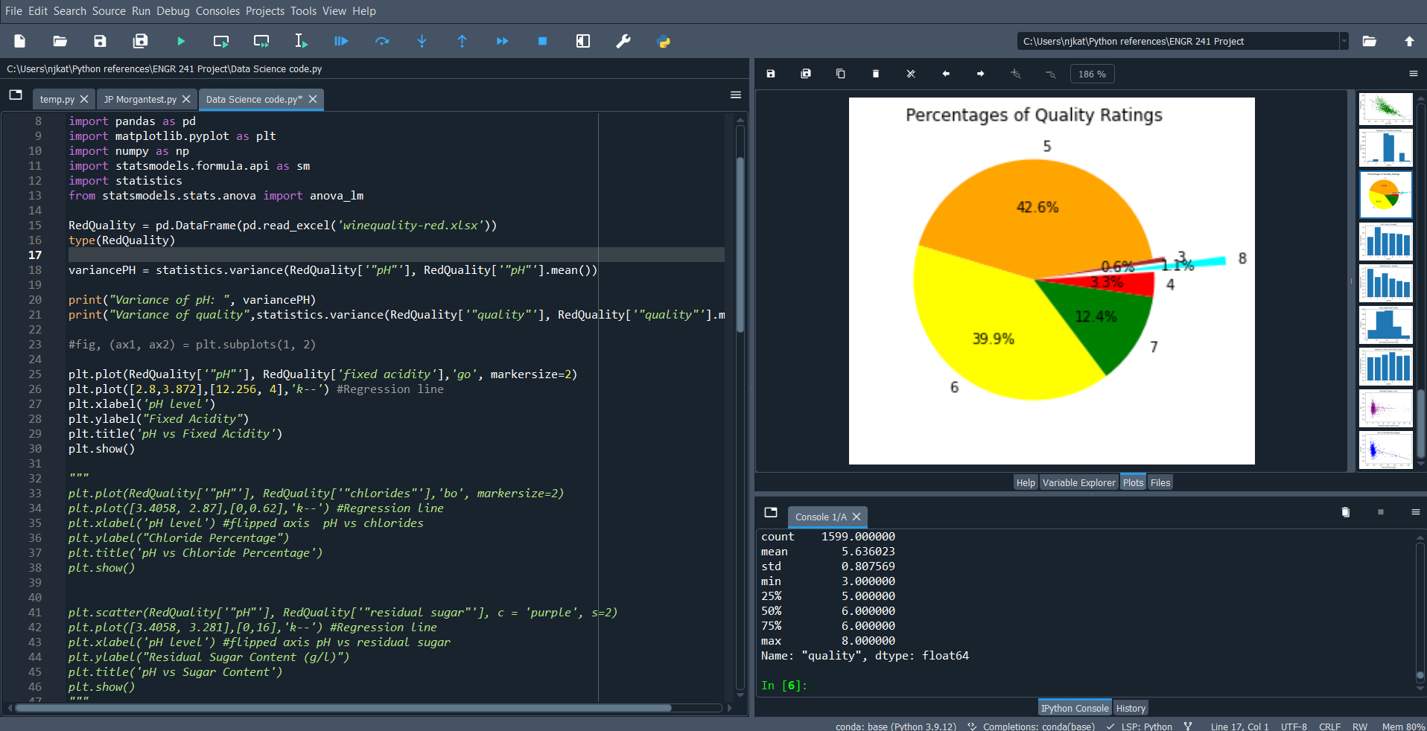
How we made the graphs:
Python code in Spyder compiler:

Slide 12
Improvements for our Analysis
Filtering out information that fell in upper quartiles that did not match the majority of information
Graphing columns not considered in this analysis such as density
Constructing more regression models to further display our data.
Possibly compare this information to other data sets (White Wine)

Slide 13
What We Learned
Excluding outliers from our data can have a significant impact on overall results
How abstract concepts of linear regression & Data science applied to real data
Interpreting data in new and different ways
Learned how to utilize python libraries for Data analysis

